Slide 1
PROTECTING YOUR WORKS FROM COPYCATS
Presentation by: BOLUWATIFE SANYA

Slide 2
BROAD OUTLINE
WHY SHOULD YOUR WORK BE PROTECTED?
HOW SHOULD YOUR WORK BE PROTECTED?

Slide 3
WHY?

Slide 4
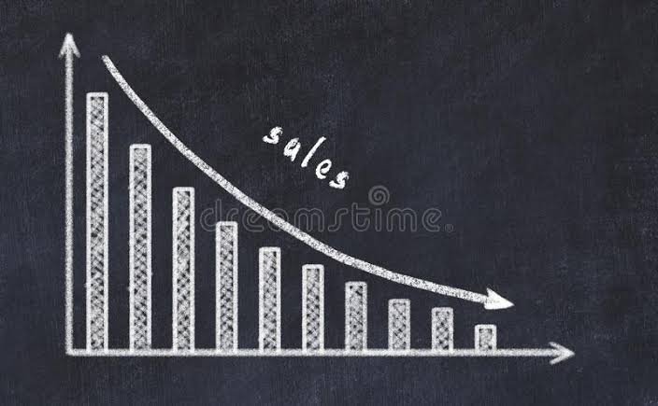
Reduction of revenue/Profit

Slide 5
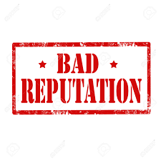
Bad brand/Reputation

Slide 6
To prove ownership

Slide 7
BUSINESS COLLAPSES!!!

Slide 8
HOW?

Slide 9
Register your work
Digital right management (DRM)
Non-disclosure agreement

Slide 10
i. Register your work in the various intellectual property offices. I.e Patents, copyright commission, designs registry, trademarks registry.

Slide 11
Just before registration, what should a creative DO?
Determine which type(s) of intellectual property right protects your work. I.e literary and artistic work- Copyright, Innovations -Patent
Examine if your work possesses the requirements of registration of that type of intellectual property right. i.e Patent-New, inventive step, industrial applicability. Copyright- Originality and Fixation.
Conduct a search (patent).
Proceed to registration.

Slide 12
THE FEAR OF INVALIDITY IS THE BEGINNING OF WISDOM
Your certificate of registration is merely a presumption of regularity just like a certificate of occupancy.
Ensure your claims cover all the necessary inventive steps. (patent)
Ensure your work satisfies all the requirements of the type of intellectual property.

Slide 13
Brief discussion on requirements and rights conferred by copyright and patent
COPYRIGHT
Copyright are rights that protect literary and artistic works. That is; rights that creators have over their literary, artistic, musical, broadcasts, cinematographic and sound recordings.
A work must fall under any of the underlined above before it can be considered for registration.
Length of protection: Throughout lifetime + 70 years.

Slide 14
Major Copyright Requirements
Originality
Independent creation – Sheldons case
Expended efforts
Fixation - Must be expressed
A medium that in can be reproduced.
Copyright protection is automatic once fixed and original. Registration is not necessary but advisable.
Notes:
This distinguishes a work which is protectable from an idea. The law does not protect an idea but it protects the expression of that idea. The work must be fixed in a tangible medium of expression. See Yeni Anikulapo Kuti & ors. v. T.M Iseli & Ors. (2003-2007) 5 I.P.L.R 53

Slide 15
IS AN IDEA COPYRIGHTABLE?

Slide 16
COPYRIGHT CONFERS TWO BROAD TYPE OF RIGHTS
Economic Rights
Moral Rights
Reproduction
Distribution to the public for commercial purpose.
Publication
Performing the work in public
Making a translation or an adaptation of the work.
Broadcast of the work
Rental
Integrity
Paternity
Integrity right means that the author can prevent anyone from mutilating, distorting or modifying his work which appears derogatory. The rationale for the integrity right is that a work is deemed to be a reflection of the author’s personality.

Slide 17
PATENT
A patent right is like a social contract wherein an inventor approaches the government to protect his invention so that another person will not commercially exploit it, the government grants the inventor protection for a specific period of time (twenty years and not renewable) while the inventor in exchange for that, discloses the step by step procedure of arriving at his invention so much so that anyone skilled in the industry of such invention can independently recreate the invention with the disclosure as a guide.

Slide 18
REQUIREMENTS
New/Novel
Never been in the prior art or a substantial development on the prior art.
Inventive step
Not obvious to a person ordinarily skilled in the industry of the product or process.
Industrial applicability
Not abstract or theoretical.
Must be useful and possess the ability of being applied for a practical purpose.

Slide 19
RIGHT CONFERRED
EXCLUSIVITY!!!

Slide 20
IS AN IDEA PATENTABLE?

Slide 21
ii. digital right management (DRM)
Digital rights management (DRM) are methods (mostly technology) used to control the use of a copyrighted work that is stored digitally.

Slide 22
WHAT DOES DRM DO?
Restricts or prevents users from editing or saving your content.
Restricts users to streaming and not allowed to download.
Restricts or prevents users from sharing or forwarding your product or content.
Restricts or prevents users from printing your content.
Disallows users from creating screenshots or screen grabs of your content.
Limits access unless permission is sought and granted.
Ensures for subscription before accessing a platform.

Slide 23
Examples of Digital Right Management Softwares or Platforms
Widevine DRM: It manages the distribution and access to contents. Presently used by Netflix, Spotify and Disney.
Playready DRM: built by Microsoft and was initially used by Netflix.
Youtube: restriction to streaming alone in some instances.
Windows Vista: this is used by Microsoft to prevent the tampering of their software.

Slide 24
iii. Non-disclosure agreement
This could be used for works that are protected by trade secrets.
Requirements of Trade secrets
The information must be commercially valuable.
It must be known to only a limited group of persons.
Reasonable steps have been taken by the owner of the trade secret to keep the information secret either by confidentiality agreement amongst business partners or contract of employment.

Slide 25
Coca-cola example
A prominent example of the use of trade secret system is the formula of Cocacola and their products. The procedures for protecting the formula for Coca‐Cola (a.k.a. "Merchandise 7X"), according to an affidavit deposed to by a senior vice‐president and general counsel for Coca‐ Cola in a court case, are as follows: The written version of the secret formula is kept in a security vault at the Trust Company Bank in Atlanta, and that vault can only be opened by a resolution from the Company's Board of Directors. It is the Company's policy that only two persons in the Company shall know the formula at any one time, and that only those persons may oversee the actual preparation of Merchandise 7X. The Company refuses to allow the identity of those persons to be disclosed or to allow those persons to fly on the same airplane at the same time. The same precautions are taken regarding the secret formulae of the company's other cola drinks: diet Coke, caffeine‐free diet Coke, TAB, caffeine‐free TAB and caffeine‐free Coca‐Cola.

Slide 26
SUMMARY
COPYRIGHT
PATENT
Registration.
Digital rights management
TRADE SECRET
Non-disclosure agreement
Registration

Slide 27
Frequently asked questions
Who owns the copyright in employment relationship?
Who owns the patent in employment relationship?
If I tell my friend my idea and he goes ahead to execute it, can I sue him?
Is the inventor always the owner of the patent?

Slide 28
THANK YOU.
BOLUWATIFE SANYA
08147439799
boluwatifesanya1@gmail.com
boluwatifesanya@paddlesolicitors.com

